Slide 1
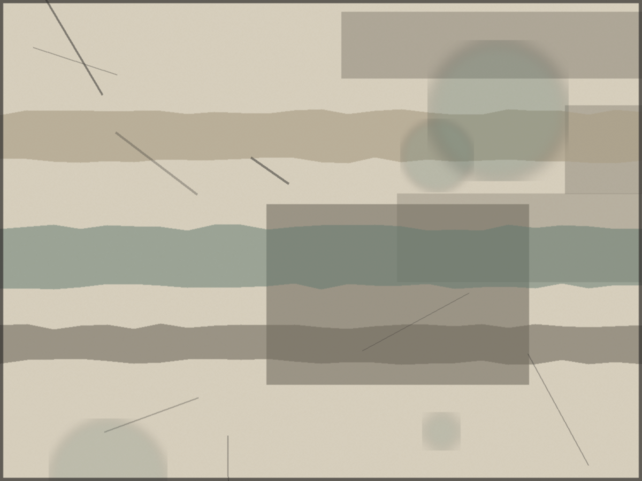
HARRINGTON ARTS ACADEMY | FOUNDATIONS DEPARTMENT
Monotype and Collage
FND 104, Foundations of Mixed Media. A studio session on pulling a first print and building a considered surface.
Instructor: Nancy Crawford. Tuesday and Thursday, 10 a.m. to 1 p.m., Studio Building, Room 212. Fall 2025.

Slide 2
SESSION AIMS
What you leave knowing
Pull a basic monotype and understand ink as a single breath on the plate.
Compose with collage and found materials toward a considered surface.
Speak clearly and generously in critique about your work and others'.
Record decisions, not just results, in your process journal.
FND 104 Foundations of Mixed Media | N. Crawford
2 / 10

Slide 3
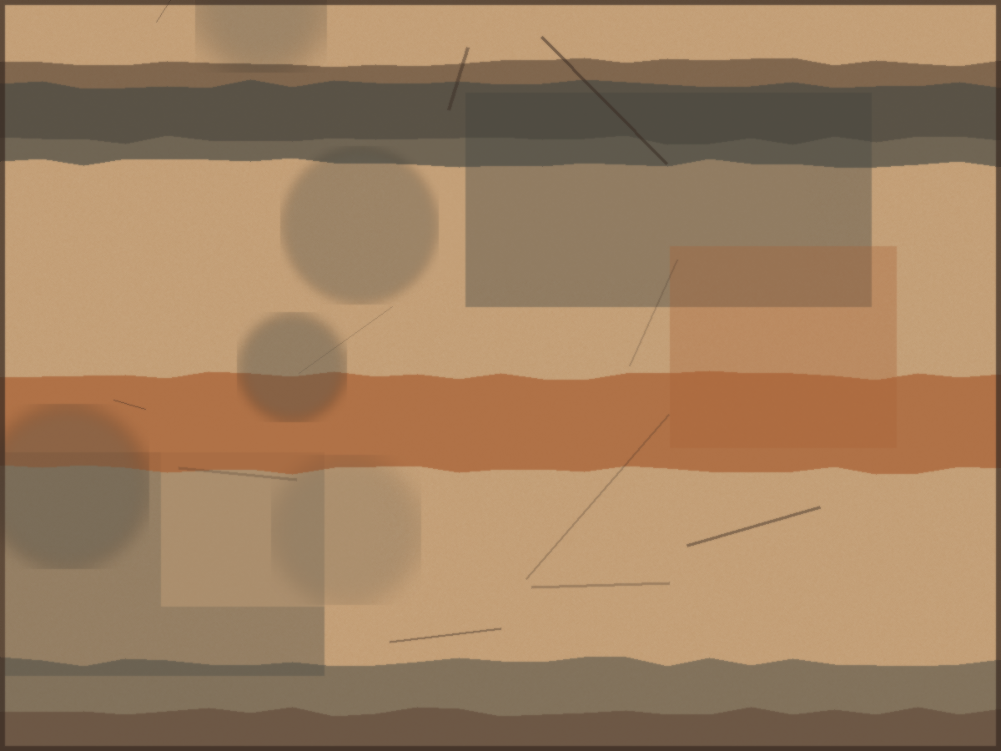
WHAT IS A MONOTYPE
One plate, one breath
A monotype is a single printed image. You work ink directly on a smooth plate, then pull one strong impression. There is no edition. The plate keeps a ghost, never the same twice. That is the point: it teaches you to commit to a mark and to accept what the press gives back.
FND 104 Foundations of Mixed Media | N. Crawford
3 / 10

Slide 4
DEMONSTRATION
Five steps to a first pull
1
Ink the plate
Roll a thin, even film. Less than you think.
2
Work the image
Wipe, draw, and lift ink. Rags, brushes, your hands.
3
Register the paper
Dampened paper, lined up square to the plate.
4
Run the press
Even pressure, one steady pass. Do not peek.
5
Pull and read
Lift slowly. Read what the plate told you.
FND 104 Foundations of Mixed Media | N. Crawford
4 / 10

Slide 5
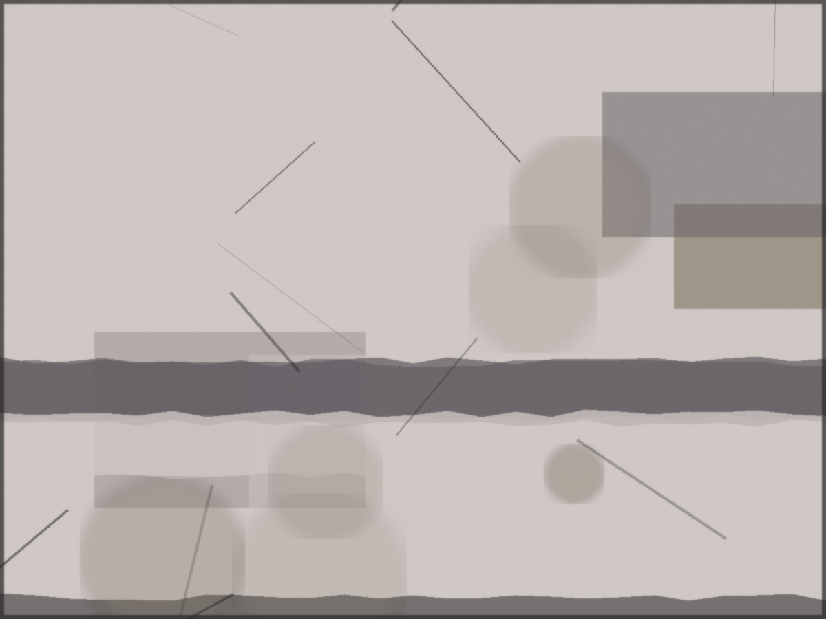
COLLAGE PRINCIPLES
Holding two surfaces in one frame
Found material carries time. Let it stay a little dirty.
Two unrelated surfaces, held until they agree to be seen together.
Glue last. Compose dry, move things, then commit.
Edges matter. A torn edge speaks differently from a cut one.
FND 104 Foundations of Mixed Media | N. Crawford
5 / 10

Slide 6
COMPOSITION
Where the eye goes
01
02
03
Weight
Movement
Restraint
Balance dark against light, busy against quiet.
Lead the eye in, around, and to a place of rest.
Leave room. Not every inch needs to work hard.
FND 104 Foundations of Mixed Media | N. Crawford
6 / 10

Slide 7
CRITIQUE NORMS
How we talk about work
Describe before you judge. Say what you see first.
Speak to the work, not the person. Be generous and precise.
Ask the maker one real question before offering advice.
Take notes on your own piece. Listening is half the grade.
FND 104 Foundations of Mixed Media | N. Crawford
7 / 10

Slide 8
ASSIGNMENT AND GRADING
Due at the next session
Pull three monotypes and build one collage that incorporates at least one printed surface and one found material. Bring your process journal with notes on what you chose and why.
Studio work and growth
50%
Participation and critique
25%
Process journal
15%
Final portfolio
10%
FND 104 Foundations of Mixed Media | N. Crawford
8 / 10

Slide 9
TERM AT A GLANCE
Fall 2025
Weeks
Focus
Due
Weeks 1 to 3
Mark, surface, and the process journal
Journal check, week 3
Weeks 4 to 6
Monotype and relief printmaking
Print set, week 6
Weeks 7 to 9
Collage and composition
Collage study, week 9
Weeks 10 to 12
Found materials and assemblage
Assemblage, week 12
Weeks 13 to 14
Final portfolio and critique
Portfolio, December 11
FND 104 Foundations of Mixed Media | N. Crawford
9 / 10

Slide 10
Try things, and fail usefully
Plain language, steady work, and respect for the room. Ask questions early.
Office hours Thursday after class, by arrangement. ncrawford@harringtonartsacademy.edu

